Slide 1

CACFP Monitoring Requirements
Notes:
Monitoring means to observe and check the progress or quality of something over a period of time and to keep it under systematic review.
It is an evaluation or assessment of the facility program operation.

Slide 2
Monitoring Requirements
(Sponsoring Organizations Only)
Review your center for compliance
Sponsoring Organizations - required
Monitoring Schedule – Per Year
  2 Unannounced Visits
  1 Announced Visit
  No more than 6 months apart
Monitoring Required Form
  5 - Day Reconciliation
Notes:
A sponsoring organization is an entity that operates two or more affiliated sites participating on the CACFP and must be entirely responsible for overseeing the administration and operation of the food program at those sites.
A sponsoring organization has a business address that is separate from the location of the physical center.
For example ABC daycare is on 123 Road but under them are different facilities A daycare and B daycare and they are at different addresses. ABC daycare would be the sponsoring organization.
Sponsoring Organizations must review their center for compliance 3 times per year.
2 Unannounced visits and 1 unannounced

Slide 3
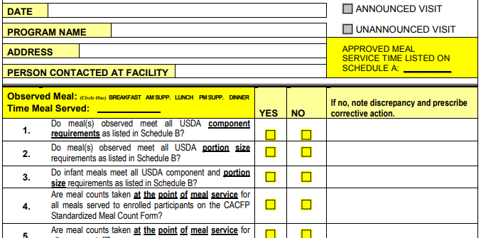
Notes:
Sample of the monitoring form. Observing one meal service, checking components, portion sizes and ensuring that the meals counts are taken at the point of meal service.

Slide 4
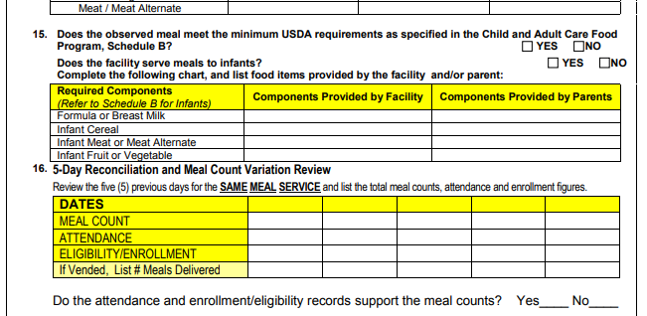
Notes:
The form also includes the components for infants if applicable.

Slide 5
5-Day Reconciliation Review
Review the five (5) previous days for the SAME MEAL SERVICE and list the total meal counts, attendance and enrollment figures.
DATE
4/13/2020
4/14/2020
4/15/2020
4/16/2020
4/17/2020
MEAL COUNT
2
2
3
5
2
ATTENDANCE
2
2
3
3
2
ELIGIBILITY/ENROLLMENT
4
4
4
4
4
DATE
MEAL COUNT
ATTENDANCE
ELIGIBILITY/ENROLLMENT
Notes:
ASK YOURSELF
Do the attendance and enrollment/eligibility records support the meal counts?
Do the meal counts show variation for the 5-day period? (in this case you would be going back to five previous days)
If No variation, continue to review 10 additional days (for a total of 15 consecutive days) for THE SAME MEAL SERVICE, (FOR EXAMPLE LUNCH) and list the total meal counts, attendance and enrollment figures.
Existing: Do you notice anything about this form?

Slide 6

Five-Day Reconciliation
Who’s required?
Day care home or sponsored center
What’s reviewed?
Comparison of enrollment, attendance, and meal counts – for a five-day period.
Why review?
Is a simple way for sponsoring organization monitors to look for consistency and determine that meal counts and claims are reasonable.
Notes:
Reconciliation of meals counts is effective as a quick spot check to highlight red flags in claiming procedures, without requiring the collection of multiple sets of records.
Attendance serves as an edit check for meal counts. Enrollment serves as an edit check on attendance. The reconciliation works because meal counts can never exceed the number of children recorded in attendance at the day care home or center.

Slide 7

HOUSEHOLD CONTACT
What is household contact?
  Contacts made by a sponsoring organization or a State agency to the participant’s home in order to verify the attendance and enrollment of the child and the specific meal service(s) which the child routinely receives while in care.
  *Adults, At Risk, Homeless Shelters are excluded*
Notes:
The Household Contact is another verification check to ensure the child’s attendance, enrollment and ensuring the child is present during meal service.

Slide 8
Preparing for Your
Administrative Review
You will receive:
  Administrative Review Appointment Letter
  Administrative Review Checklist
  Administrative Pre-view Fact Sheet
Prepare your center (clean facility, i.e. meal service areas, review sanitation procedures, post required documents, etc.).
Review CACFP Procedures (meal counts, daily attendance, CACFP contracts, etc.).
Notes:
The purpose of the administrative review is to evaluate the overall operation, to ensure all USDA’s regulations are met.
You will be sent a letter stating when the review will be taking place.
a. You will be provided a review checklist which will specify which month we will be reviewing.
b. The pre-view fact sheet is a guideline to help you prepare for the administrative review.
Majority of the information will be uploaded into the CARES system.

Slide 9
After Your Administrative Review
You will receive:
  Corrective Action Letter
  Administrative Review Form
  Site Review Form
  Overclaim (if applicable)
Pay attention to corrective action deadlines.
Maintain documentation for five years.
Notes:
At the exit conference. You will receive a copy of the administrative review, corrective actions

Slide 10
CORRECTIVE ACTION SAMPLE
Submit a written corrective action plan (CAP) explaining:
  Who is/are responsible for implementing and complying with the process and/or procedures? (Name and Title)?
  What process and/or procedures will be implemented to correct the findings? (Detail)?
  When will the process and/or procedure be implemented? (Specific date)?
  Where will the corrective action plan documentation be retained/ stored/ filed?
  How often will this information be collected? How will the program ensure that the processes and/or procedures are followed consistently in order to prevent future findings? (Detail)
Notes:
A corrective action is the action the facility will take within a specific time frame to address the finding(s) of noncompliance and to prevent it from recurring. 2 CFR 200.26.
Specific- Detailed, step by step actions
Measurable- Does this plan solve the problem
Attainable- Do staff have the needed skill-set and training
Realistic- Do you have enough resources to make this happen
Timely- When will it happen? How often?

Slide 11
Some C.A. must be < 30 Days
Unlawful practices
  False or fraudulent claims
  False information on application
  Concealed past performance problems

Slide 12
C.A. May Take Up to 90 Days
Training
Monitoring
Certain recordkeeping problems
Some performance standards problems

Slide 13
Some C.A. May Take Over 90 Days
Long-term changes to management systems or processes
  Computer system changes
  Certain personnel
However, Must have C.A. Plan
  Within 90 days
  Completion date and milestones for completing specific tasks

Slide 14
Temporary Hold for Non-Compliance
2 CFR 200.338
If a non-Federal entity fails to comply with Federal statutes, regulations or the terms and conditions of a Federal award, the Federal awarding agency or pass-through entity may impose additional conditions, as described in §200.207 Specific conditions. If the Federal awarding agency or pass-through entity determines that noncompliance cannot be remedied by imposing additional conditions, the Federal awarding agency or pass-through entity may take one or more of the following actions, as appropriate in the circumstances:
  (a) Temporarily withhold cash payments pending correction of the deficiency by the non-Federal entity or more severe enforcement action by the Federal awarding agency or pass-through entity.
  (b) Disallow (that is, deny both use of funds and any applicable matching credit for) all or part of the cost of the activity or action not in compliance.
  (c) Wholly or partly suspend or terminate the Federal award.
  (d) Initiate suspension or debarment proceedings as authorized under 2 CFR part 180 and Federal awarding agency regulations (or in the case of a pass-through entity, recommend such a proceeding be initiated by a Federal awarding agency).
  (e) Withhold further Federal awards for the project or program.
  (f) Take other remedies that may be legally available.
Notes:
Pending corrective actions can be placed on a temporary hold until the correction actions are received.

Slide 15
DEFICIENCIES =
CORRECTIVE ACTIONS
REQUIRED

Slide 16
DEFICIENCIES =
OVERCLAIMS
$$$$

Slide 17
Corrective Action
DEADLINES !!!!!

Slide 18
Completing the Review Cycle
Initial Administrative Review Letter
CARES Site/Home Review Form
Corrective Action Timeline
CARES Administrative Review Form
SA Determination
Hearing Official Determination
Seriously Deficient Process
Sponsor Appeals

Slide 19
The Six Steps in the Serious Deficiency Process
Identify the serious deficiencies (SD);
Issue a notice of serious deficiency (SD);
Receive and assess the institution’s written corrective action plan (CAP) for adequacy;
Issue a notice of temporary deferral of the serious deficiency if the CAP is approved, or issue a notice of proposed termination and disqualification, including appeal procedures, if the CAP is not adequate (or if no CAP plan is received);
Provide an appeal review (appeal hearing, administrative review), if requested, of the proposed termination and disqualification; and
Issue a notice of final termination and disqualification if the appeal is upheld or if the timeframe for requesting an appeal has passed, or issue a notice of temporary deferral if the appeal is overturned.
Notes:
What is seriously deficient:
The status of an instuition, sponsoring organization or daycare home that has been determined to be noncompliant in one or more aspects in its operation of the program.
READ THE STEPS!!!
The State agency must withhold Program reimbursement as of the beginning of the serious deficiency process and to release payment for valid claims during the suspension period if the institution requests a suspension review and is upheld.

Slide 20
SERIOUSLY DEFICIENT CORRECTIVE ACTIONS
What are the serious deficiency(ies) and the procedures that will be implemented to address the serious deficiency(ies)?
Who will address the serious deficiency? List personnel responsible for this task.
When will the procedure for addressing the serious deficiency be implemented? Provide a timeline for implementing the procedure (i.e., will the procedure be done daily, weekly, monthly, or annually, and when will it begin?)
Where will the CAP documentation be retained? • How will the staff and facilities or providers be informed of the new policies and procedures (e.g., Handbook, training, website, etc.)?
Notes:
Seriously deficient corrective actions may not be submitted to the hearing official once the hearing begins. In order to be considered, all parties, including the State agency, must submit any written documentation to the hearing official no later than 30 days after receipt of the notice of action [7 CFR 226.6(k)(5)(v)].
The deadline for ALL corrective action responses and implementation must not exceed 30 days.
Specific- Detailed, step by step actions
Measurable- Does this plan solve the problem
Attainable- Do staff have the needed skill-set and training
Realistic- Do you have enough resources to make this happen
Timely- When will it happen? How often?

Slide 21
Determining Serious Deficiencies
1. The severity of the problem
Is the noncompliance on a minor or substantial scale?
Are the violations indicative of a systemic problem at the institution, or
Is the problem truly an isolated event?
Even minor problems may be serious if systemic. Some problems are serious even though they have occurred only once.
EXAMPLE: Missing menu items for one day out of a month would require technical assistance, while a second review with the same issue or numerous menu problems on an initial review could rise to the level of a serious deficiency.
Notes:
Existing: Can you list any examples of a serious deficiency?
-Submission of false information on the application
-Submission of false claims for reimbursement
-Simultaneous participation under more than one sponsoring organization
-Non-compliance with the Program meal pattern
-Failure to keep required records (i.e. meal counts, menus, etc.)

Slide 22
Determining Serious Deficiencies
2. The degree of responsibility attributable to the institution.
To the extent that evidence is available,
  can the State agency determine whether the violations were inadvertent errors of an otherwise responsible institution?
  Is there evidence of negligence or a conscious indifference to regulatory requirements? Or, even worse, is there evidence of deception?
3. The institution’s history of participation in the Program.
  Is this the first time the institution is having problems or has noncompliance occurred frequently at the same institution?
Notes:
Were the deficiencies caused by accident or was it on purpose?
Is there history regarding seriously deficiencies?

Slide 23
Determining Serious Deficiencies
The nature of the requirements that relate to the problem.
  Are the institution’s actions a clear violation of Program requirements?
  Has the institution incorporated the new policies correctly?
The degree to which the problem impacts Program integrity.
  Are the violations undermining the intent or purpose of the CACFP such as misuse of funds for nonProgram purposes, or
  simply an administrative error [7 CFR 226.6(b)(1)(xviii); (b)(2)(vii), and CACFP 30-2006,
Notes:
A clear violation?
Remember the VCA performance standards.

Slide 24
Temporarily Deferred
Notes:
Slippery Slope!
Being SD is real and has real consequences. Centers HAVE been terminated from the Program and added to the National Disqualified List (NDL). You and everyone associated with the program that is listed on the responsible parties/ principals in CARES will be placed on the National Disqualification List for 7 years!

Slide 25
Suspension Process for Institutions
imminent threat to the health or safety of Program participants or the public;
may not be appealed prior to the suspension.
submission a false or fraudulent claim for reimbursement;
a proposed suspension which is appealable prior to the suspension
Notes:
Existing: What are examples of Imminent threat?
Inadequate or incompetent supervision
Unsanitary conditions for food service
Providing care for more children than the licensed capacity allows
If the State agency determines that an institution has knowingly submitted a false or fraudulent claim, the State agency may initiate action to suspend the institution’s participation, terminate the institution’s agreement, disqualify the institution and the responsible principals and responsible individuals.

Slide 26
Thank you!

